Slide 1
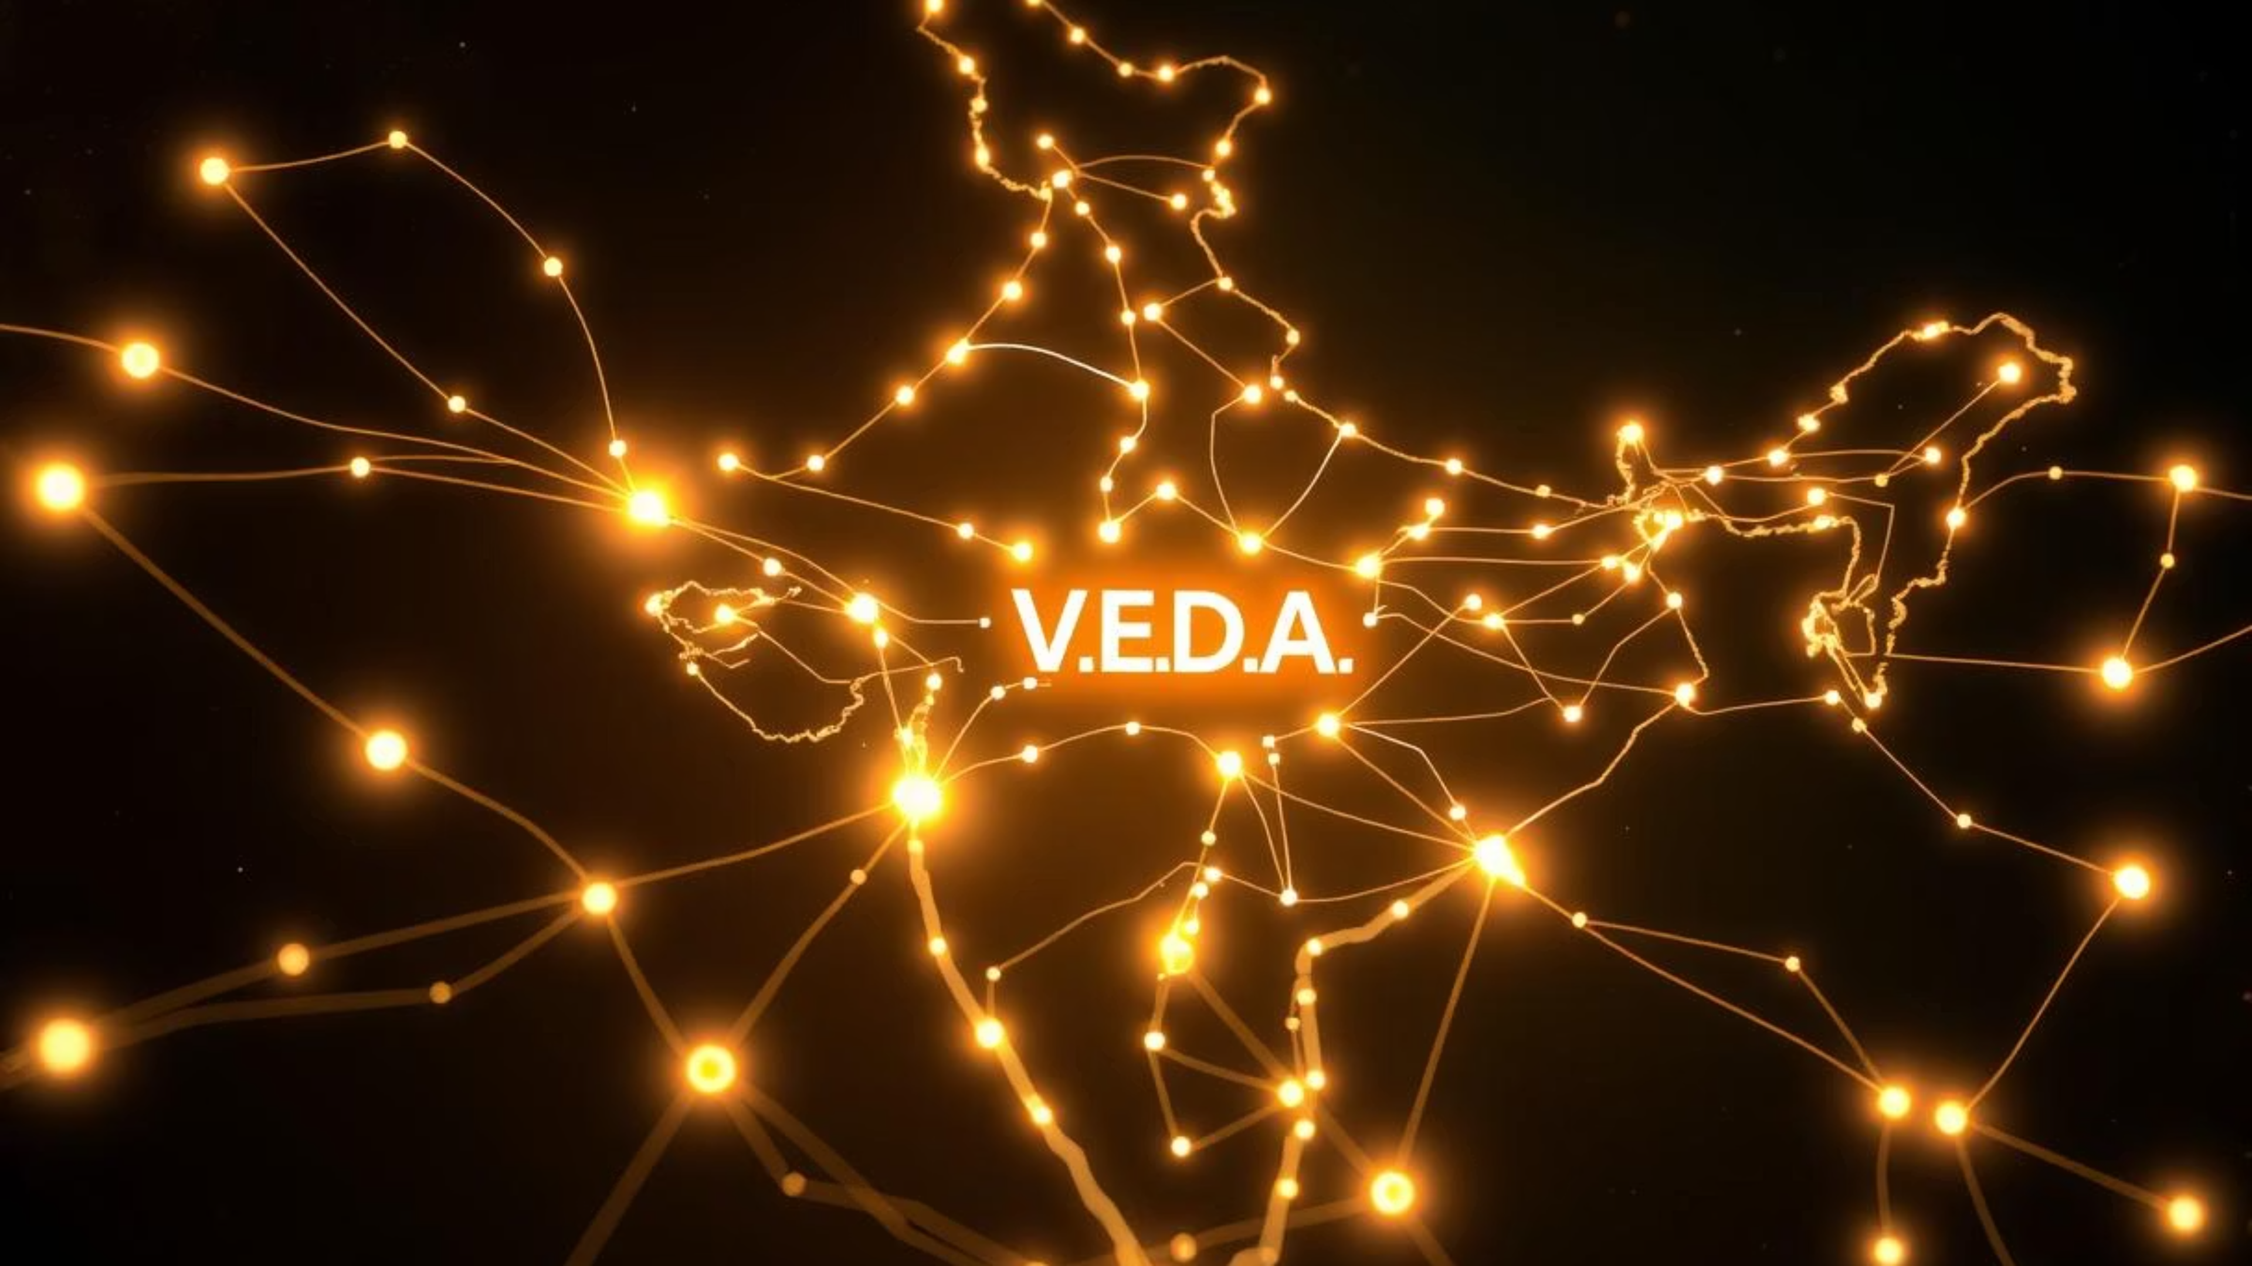
R.A.Y.A - India's Indigenous AI Ecosystem
Powered by V.E.D.A (Visionary Engine for Digital Advancement)
Pioneering Digital Independence and Innovation for India's Future

Slide 2

The Challenge: India's Digital Over-Dependence
India, a rapidly advancing digital nation, faces a critical challenge: an over-reliance on foreign AI and digital ecosystems. This dependency creates significant vulnerabilities, from data security concerns to the absence of AI solutions truly tailored to India's unique sociocultural and economic landscape.
Lack of Indigenous AI Infrastructure: Without a robust, homegrown AI backbone, India's digital future remains largely influenced by external forces, limiting its sovereignty in the technological domain.
Absence of Culturally & Linguistically Relevant AI: Existing AI solutions often fail to address the rich cultural, linguistic, and business diversity that defines India. This leads to generic applications that miss the nuance and specific needs of the Indian populace.
"India's future as a global power is intrinsically linked to its leadership in AI. Without an indigenous AI ecosystem, our progress and autonomy in the global digital arena are fundamentally threatened."
The time is now for India to cultivate its own AI leadership, ensuring that digital innovation serves its people and its unique national interests first.

Slide 3




Our Vision: Forging India's AI Destiny
At R.A.Y.A, our vision transcends mere technological development; it's about sculpting a future where India stands at the forefront of AI innovation, driven by self-reliance and global impact.
Building India’s Own AI Ecosystem
Enabling Digital Independence & Self-Reliance
Creating a comprehensive and integrated AI framework from the ground up, designed by Indians, for Indians, and for the world.
Empowering the nation with the tools and infrastructure to control its own digital destiny, reducing reliance on external technologies and fostering data sovereignty.
Pioneering Research Towards Type 1 Civilization
Empowering Individuals & Small Businesses
Democratizing access to powerful AI tools, enabling everyone from local entrepreneurs to individual learners to thrive in the digital age.
Committing to cutting-edge AI and quantum research that contributes to humanity's advancement towards a Type 1 Civilization, capable of harnessing all energy on its home planet.
This vision is a commitment to not just technology, but to a brighter, more independent, and innovative future for India.

Slide 4

Unveiling R.A.Y.A: Responsive AI for You Always
R.A.Y.A is more than just an acronym; it's the embodiment of India's ambition to create a truly inclusive and accessible AI ecosystem. It stands for "Responsive AI for You Always," reflecting our commitment to ubiquity and user-centricity.
A Community-Driven AI Ecosystem
R.A.Y.A is built on the principles of collaboration and open development, ensuring that its evolution is shaped by the diverse needs and contributions of the Indian community.
Tailored for Indian Needs
Unlike generic AI, R.A.Y.A understands and integrates India's cultural nuances, linguistic diversity, and unique business challenges, offering truly relevant solutions.
From Daily Companions to Advanced Platforms
Whether it's a simple AI assistant for daily tasks or a complex AI platform for industrial applications, R.A.Y.A aims to cater to a broad spectrum of user needs.
A 'Make in India' Movement for AI
R.A.Y.A champions self-reliance, fostering indigenous talent, technology, and infrastructure to build a truly Made in India AI revolution.

Slide 5




Introducing V.E.D.A: Visionary Engine for Digital Advancement
At the heart of R.A.Y.A lies V.E.D.A, our "Visionary Engine for Digital Advancement." V.E.D.A is not just a technological component; it's the intellectual core, the self-learning brain that gives R.A.Y.A its power and intelligence.
The Core AI Brain Powering R.A.Y.A
A Self-Learning AI Knowledge Engine
Foundation for India's Own AI-Powered Search Engine & Knowledge Base
V.E.D.A serves as the central processing unit, enabling R.A.Y.A's diverse functionalities, from natural language processing to complex problem-solving.
Designed to continuously learn, adapt, and grow, V.E.D.A expands its knowledge base and refines its understanding based on interactions and new data, ensuring it remains at the cutting edge.
V.E.D.A is the bedrock upon which India's future independent search engine and a comprehensive, indigenous knowledge base will be built, offering unparalleled access to information rooted in Indian context.
With V.E.D.A, R.A.Y.A aims to provide intelligent, relevant, and reliable AI solutions that are deeply integrated with India's unique informational and cultural landscape.

Slide 6
Key Pillars of R.A.Y.A Powered by VEDA
The R.A.Y.A ecosystem, powered by the VEDA engine, is built upon five foundational pillars that define its mission and scope. These pillars ensure a holistic approach to AI development, focusing on national independence, innovation, economic empowerment, and community engagement.
1
Digital Independence
Empowering India to own its digital future by reducing reliance on foreign technologies and fostering a self-sustaining AI infrastructure. This pillar focuses on data sovereignty and secure digital ecosystems.
2
Indigenous AI Innovation
Driving cutting-edge research and development within India, creating unique AI solutions that are culturally relevant, linguistically diverse, and globally competitive.
3
AI Automation for Small Businesses
Democratizing AI access for Micro, Small, and Medium Enterprises (MSMEs), providing tools that enhance efficiency, automate tasks, and foster growth in the Indian economic landscape.
4
AI-Powered Learning & Companion Tools
Developing intelligent assistants and educational platforms that make learning accessible, personalized, and engaging for individuals across all age groups and backgrounds.
5
Community Collaboration & Open Development
Fostering an open-source environment where developers, researchers, and enthusiasts can contribute, share knowledge, and collectively build the future of R.A.Y.A.

Slide 7

Current Applications: R.A.Y.A Lite in Action
R.A.Y.A Lite is our initial offering, providing practical and accessible AI solutions that demonstrate the immediate impact and potential of our indigenous ecosystem. These applications are designed to seamlessly integrate into daily life and empower users and entrepreneurs.
AI WhatsApp Companion
Get instant updates on news, weather forecasts, and even share a joke. This companion also serves as a personalized learning assistant, making information readily available.
WhatsApp Automation for Entrepreneurs
Streamline customer interactions, automate responses, and manage inquiries directly through WhatsApp, empowering small business owners with efficient communication tools.
Digital Task Management & Time-saving AI Assistants
Utilize AI to organize your daily schedule, set reminders, and manage tasks, freeing up valuable time for more critical activities.
Foundation for Future AI Projects
These initial applications serve as a proving ground and a foundational layer for more complex and advanced AI projects within the R.A.Y.A ecosystem, constantly evolving based on user feedback.

Slide 8
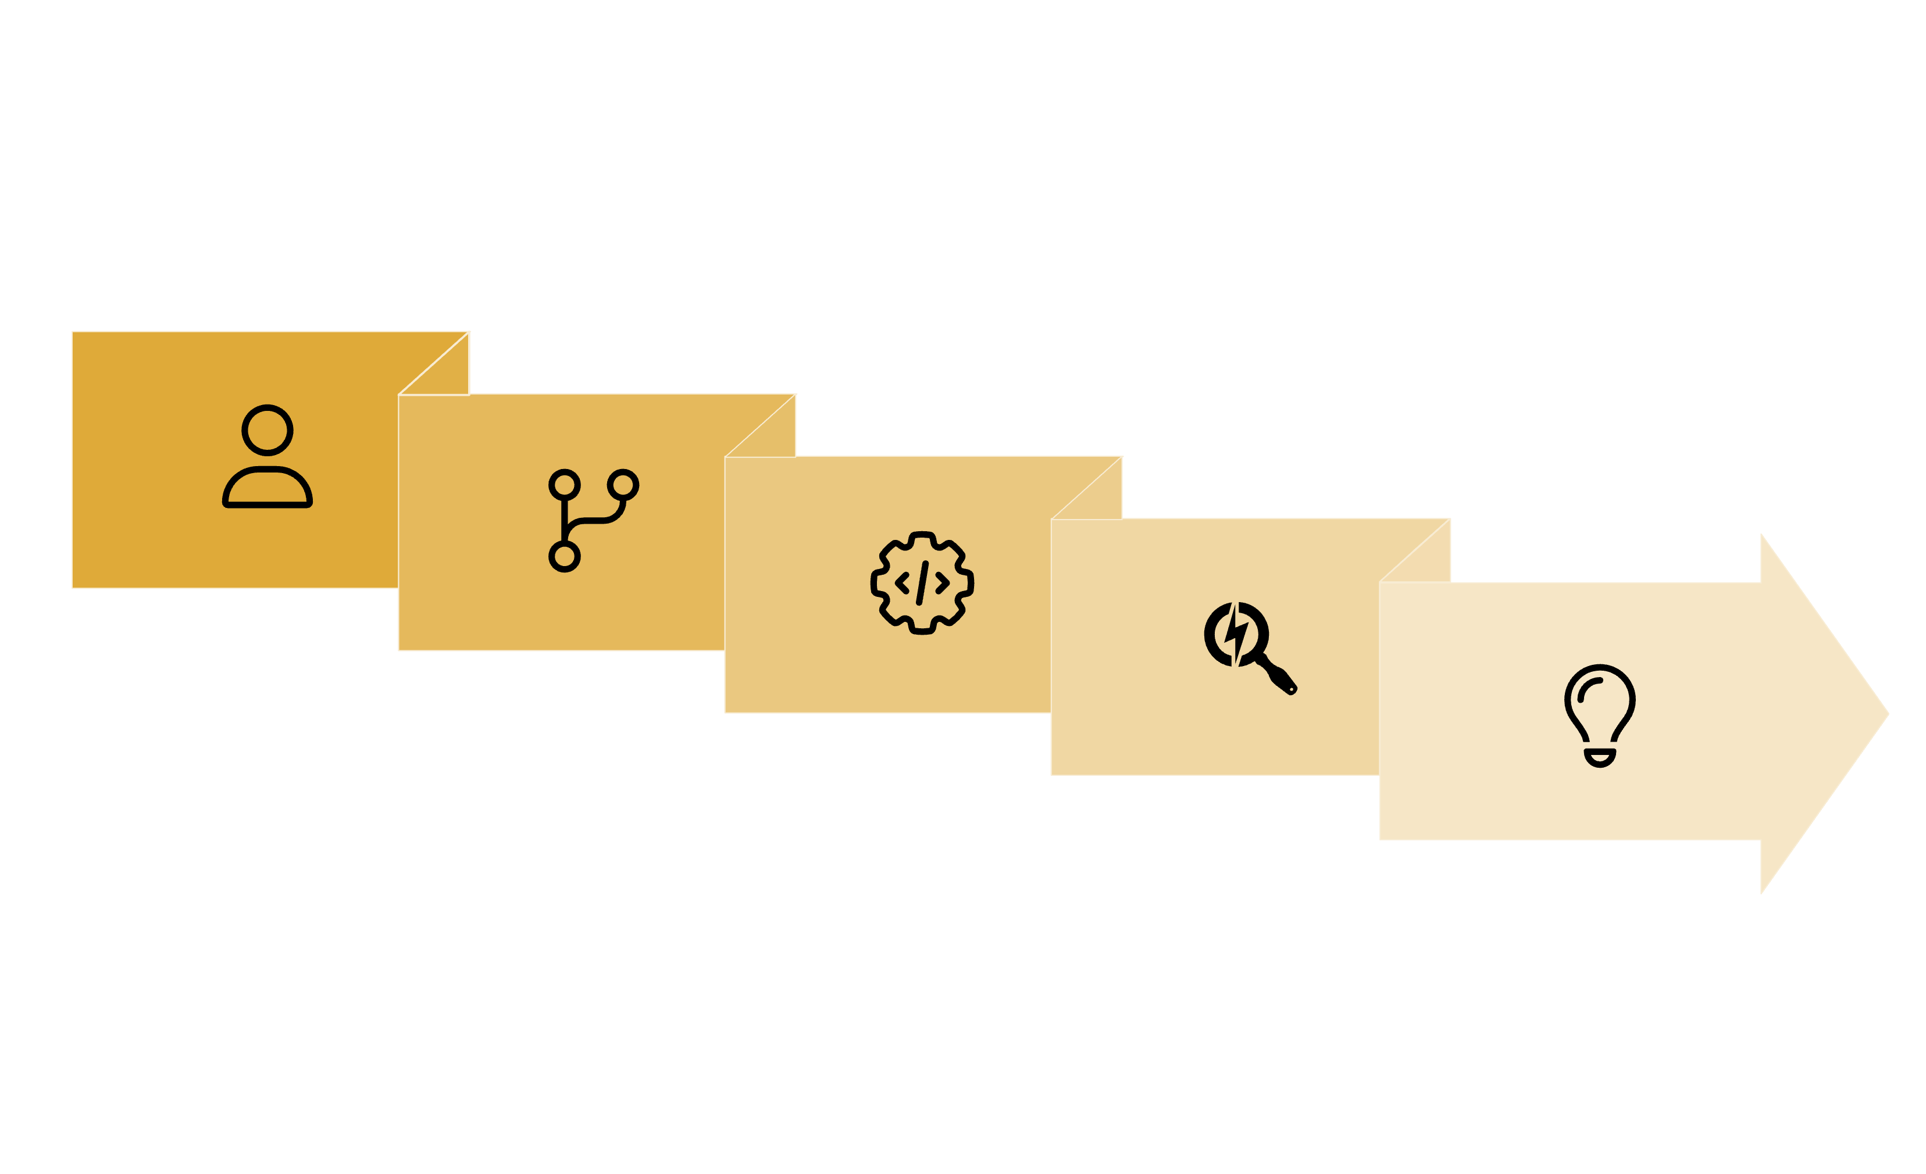





Roadmap to the Future: The R.A.Y.A & VEDA Journey
Our journey to building India's indigenous AI ecosystem is structured in distinct phases, each building upon the last to achieve our ambitious goals, culminating in pioneering research that extends beyond our planet.
Community Build
Core Engine
Advanced Research
Feature Dev
Search Launch
This phased approach ensures a systematic and sustainable development of R.A.Y.A and VEDA, allowing for continuous innovation and adaptation to meet the evolving needs of India and the world.

Slide 9



How You Can Contribute: Be a Part of the AI Revolution
The success of R.A.Y.A hinges on the collective strength and passion of its community. We invite individuals from all walks of life to join us in this monumental endeavor. Your contribution, no matter how big or small, will help shape India's AI future.
1
2
Join the R.A.Y.A Community
Become a Volunteer
Connect with like-minded individuals, share ideas, and stay updated through our dedicated WhatsApp Group. This is where the conversation begins.
Lend your skills in development, content creation, outreach, or project management. Every effort helps in accelerating R.A.Y.A's growth.
3
4
Collaborate on Open-Source Projects
Be a Supporter & Spread the Movement
For developers and tech enthusiasts, contribute directly to the R.A.Y.A codebase and help build the next generation of AI tools.
Even if you can't code, you can support us by sharing our vision, spreading awareness, and encouraging others to join the R.A.Y.A family.

Slide 10


Call to Action
India’s AI Future Needs You!
The vision of an indigenous AI ecosystem, fostering digital independence and global leadership, is within reach. But it requires collective effort. Join us in building R.A.Y.A and be a part of this transformative journey.
Together, let's ignite India’s AI Revolution and build a digitally sovereign and innovative nation.

